Slide 1
Computer Networks（01）
An Introduction
lijt@fudan.edu.cn
Some slides from Jim Kurose

Slide 2
Introduction
Our goal:
get “feel” and terminology
more depth, detail later in course
approach:
  use Internet as example
Overview:
what’s the Internet
what’s a protocol?
network edge
network core
access net, physical media
Internet/ISP structure
performance: loss, delay
protocol layers, service models
network modeling
Introduction
1-<number>

Slide 3

Course Non-goals
Learn how to configure a Cisco router
  That requires a class all by itself
  Cisco teaches those classes
  Our perspective will be broader
Become “Internet Experts”
  The Internet will be our frequent motivating example
  Our perspective will be broader

Slide 4
Why not an “Internet class”?
Is there anything other than the Internet?
  Give two examples ？

Slide 5
Course Goals
Think “the network way”
  Distributed coordination is hard
Learn how computer networks work
  Problems, approaches, protocols, software
Learn how to write network applications
Hands-on understanding of network internals
  Course Projects

Slide 6
What Is a Network?
Collection of nodes and links that connect them
This is vague. Why? Consider different networks:
  Internet
  Social networks
  Telephone
  Others
    – transport nets, sensor nets, cell phones, …
Focus on Internet, but understand important common issues and challenges

Slide 7
Different Network Views
A network is a shared infrastructure that supports communication for many users.
  Sharing view: how do users share the network?
Many network technologies exist.
  Technology view: how do the technologies coexist?
Networks are owned and managed by multiple organizations.
  Management view: how does global communication take place?
Networks cover different geographic areas.
  Geographic view: network diameter?
Networks run many protocols that are responsible for different functions.
  Protocol view: how are the many protocols coordinated?

Slide 8
How to Draw a Network
Node
Link
Node

Slide 9
Building block: The Links
Electrical questions
  Voltage, frequency, …
  Wired or wireless?
Link-layer issues: How to send data?
  When to talk – can everyone talk at once?
  What to say – low-level format?
  Stay tuned for lecture 3-4
Okay… what about more nodes?
Node
Link
Node

Slide 10
… But what if we want more hosts?
Scalability?!
One wire
Wires for everybody!

Slide 11
Multiplexing!
Need to share network resources
How? Switched network
  Party “A” gets resources sometimes
  Party “B” gets them sometimes
Interior nodes act as “Routers” or “Switches”
What mechanisms can share resources?

Slide 12
What is a Computer Network
Interconnected;
Autonomous;
Collection.
Modeling :
End system + Switching node +Link

Slide 13
Networks Juggle Many Goals
Efficiency – resource use; cost
The “ilities”:
  Evolvability
  Managability
  Security (securability, if you must)
  Ease of:
    Creation
    Deployment
    Management
    Creating useful applications
  Scalability

Slide 14
Roadmap
  1.1 What is the Internet?
  1.2 Network edge
  1.3 Network core
  1.4 Network access and physical media
  1.5 Internet structure and ISPs
  1.6 Delay & loss in packet-switched networks
  1.7 Protocol layers, service models
  1.8 History
Introduction
1-<number>

Slide 15



















What’s the Internet: “nuts and bolts” view
PC
millions of connected computing devices: hosts
  running network apps
mobile network
server
wireless
laptop
global ISP
smartphone
home
network
communication links
  fiber, copper, radio, satellite
  transmission rate: bandwidth
regional ISP
wireless
links
wired
links
routers: forward packets (chunks of data)
router
institutional
network
Introduction
1-<number>

Slide 16


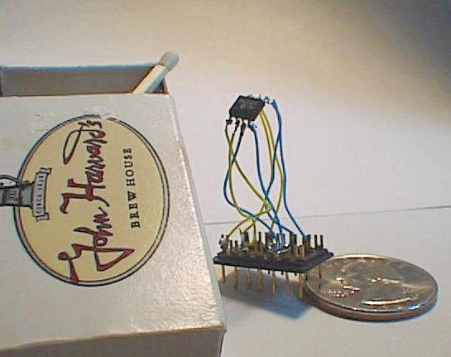

“Cool” internet appliances
Web-enabled toaster +
weather forecaster
IP picture frame
http://www.ceiva.com/
World’s smallest web server
http://www-ccs.cs.umass.edu/~shri/iPic.html
Internet phones
Introduction
1-<number>

Slide 17
What’s the Internet: “nuts and bolts” view
protocols control sending, receiving of msgs
  e.g., TCP, IP, HTTP, Skype, Ethernet
Internet: “network of networks”
  loosely hierarchical
  public Internet versus private intranet
Internet standards
  RFC: Request for comments
  IETF: Internet Engineering Task Force
mobile network
global ISP
home
network
regional ISP
institutional
network
Introduction
1-<number>

Slide 18
What’s the Internet: a service view
communication infrastructure enables distributed applications:
  Web, VoIP, email, games, e-commerce, file sharing
communication services provided to apps:
  reliable data delivery from source to destination
  “best effort” (unreliable) data delivery
mobile network
global ISP
home
network
regional ISP
institutional
network
Introduction
1-<number>
  Connectionless unreliable vs. connection-oriented reliable

Slide 19
What’s a protocol?
human protocols:
“what’s the time?”
“I have a question”
introductions
… specific msgs sent
… specific actions taken when msgs received, or other events
network protocols:
machines rather than humans
all communication activity in Internet governed by protocols
protocols define format, order of msgs sent and received among network entities, and actions taken on msg transmission, receipt
Introduction
1-<number>

Slide 20



What’s a protocol?
a human protocol and a computer network protocol:
Hi
TCP connection
request
Hi
TCP connection
response
Got the
time?
Get http://www.fudan.edu.cn/~lijingtao
2:00
<file>
time
Q: Other human protocols?
Introduction
1-<number>

Slide 21
Introduction: roadmap
  1.1 What is the Internet?
  1.2 Network edge
  1.3 Network core
  1.4 Network access and physical media
  1.5 Internet structure and ISPs
  1.6 Delay & loss in packet-switched networks
  1.7 Protocol layers, service models
  1.8 History
Introduction
1-<number>

Slide 22




A closer look at network structure:
network edge: applications and hosts
network core:
  routers
  network of networks
access networks, physical media:
  communication links
  routers
Introduction
1-<number>

Slide 23
The network edge:
end systems (hosts):
  run application programs
  e.g. Web, email
  at “edge of network”
client/server model
  client host requests, receives service from always-on server
  e.g. Web browser/server; email client/server
peer-peer model:
  minimal (or no) use of dedicated servers
  e.g. Skype, BitTorrent, KaZaA
Introduction
1-<number>

Slide 24
Network edge: connection-oriented service
Goal: data transfer between end systems
handshaking: setup (prepare for) data transfer ahead of time
  Hello, hello back human protocol
  set up “state” in two communicating hosts
TCP - Transmission Control Protocol
  Internet’s connection-oriented service
TCP service [RFC 793]
reliable, in-order byte-stream data transfer
  loss: acknowledgements and retransmissions
flow control:
  sender won’t overwhelm receiver
congestion control:
  senders “slow down sending rate” when network congested
Introduction
1-<number>

Slide 25
Network edge: connectionless service
Goal: data transfer between end systems
  same as before!
UDP - User Datagram Protocol [RFC 768]:
  connectionless
  unreliable data transfer
  no flow control
  no congestion control
App’s using TCP:
HTTP (Web), FTP (file transfer), Telnet (remote login), SMTP (email)
App’s using UDP:
streaming media, QQ, teleconferencing, DNS, Internet telephony
Introduction
1-<number>

Slide 26
Introduction: roadmap
  1.1 What is the Internet?
  1.2 Network edge
  1.3 Network core
  1.4 Network access and physical media
  1.5 Internet structure and ISPs
  1.6 Delay & loss in packet-switched networks
  1.7 Protocol layers, service models
  1.8 History
Introduction
1-<number>

Slide 27
The Network Core
mesh of interconnected routers
the fundamental question: how is data transferred through net?
  circuit switching: dedicated circuit per call: telephone net
  packet-switching: data sent thru net in discrete “chunks”
Introduction
1-<number>

Slide 28
Network Core: Circuit Switching
End-end resources reserved for “call”
link bandwidth, switch capacity
dedicated resources: no sharing
circuit-like (guaranteed) performance
call setup required
Introduction
1-<number>

Slide 29
Network Core: Circuit Switching
network resources (e.g., bandwidth) divided into “pieces”
pieces allocated to calls
resource piece idle if not used by owning call (no sharing)
dividing link bandwidth into “pieces”
  frequency division
  time division
Introduction
1-<number>

Slide 30
Circuit Switching: FDM and TDM
Example:
FDM
4 users
frequency
time
TDM
frequency
time
Introduction
1-<number>
Notes:
Two simple multiple access control techniques.
Each mobile’s share of the bandwidth is divided into portions for the uplink and the downlink. Also, possibly, out of band signaling.
As we will see, used in AMPS, GSM, IS-54/136

Slide 31
Numerical example
How long does it take to send a file of 640,000 bits from host A to host B over a circuit-switched network?
  All links are 1.536 Mbps
  Each link uses TDM with 24 slots/sec
  500 msec to establish end-to-end circuit
Let’s work it out!
Introduction
1-<number>

Slide 32
Numerical example
How long does it take to send a file of 640,000 bits from host A to host B over a circuit-switched network?
  All links are 1.536 Mbps
  Each link uses TDM with 24 slots/sec
  500 msec to establish end-to-end circuit
Let’s work it out! (10.5sec)
Introduction
1-<number>

Slide 33
More Examples
Introduction
1-<number>

Slide 34
T1/DS1 (Digital Signal Designator )
In the T1 system, voice or other analog signals are sampled 8,000 times a second and each sample is digitized into an 8-bit word. With 24 channels being digitized at the same time, a 192-bit/slot frame (24 channels each with an 8-bit word) is thus being transmitted 8,000 times a second. Each frame is separated from the next by a single bit, making a 193-bit block. The 192 bit frame multiplied by 8,000 and the additional 8,000 framing bits make up the T1's 1.544 Mbps data rate.
Introduction
1-<number>

Slide 35
Transmission Rates
Digital Signal Designator | Data Rate | DS0 Multiple | T-Carrier
DS0 | 64 Kbps | 1 | -
DS1 | 1.544 Mbps | 24 | T1
DS3 | 44.736 Mbps | 672 | T3
OC3 | 155.52 Mbps |  | Optical Carrier
OC12 | 622.08 Mbps
OC192 | 10 Gbps
OC256 | 13.271 Gbps
OC768 | 40 Gbps
Introduction
1-<number>

Slide 36
Network Core: Packet Switching
each end-end data stream divided into packets
user A, B packets share network resources
each packet uses full link bandwidth
resources used as needed
resource contention:
aggregate resource demand can exceed amount available
congestion: packets queue, wait for link use
store and forward: packets move one hop at a time
  Node receives complete packet before forwarding
Bandwidth division into “pieces”
Dedicated allocation
Resource reservation
Introduction
1-<number>

Slide 37
Packet Switching: Statistical Multiplexing
100 Mb/s
Ethernet
A
C
statistical multiplexing
1.5 Mb/s
B
queue of packets
waiting for output
link
D
E
Sequence of A & B packets does not have fixed pattern, shared on demand ➔ statistical multiplexing.
TDM: each host gets same slot in revolving TDM frame.
Introduction
1-<number>

Slide 38
Packet switching versus circuit switching
Packet switching allows more users to use network!
1 Mb/s link
each user:
  100 kb/s when “active”
  active 10% of time
circuit-switching:
  10 users
packet switching:
  with 35 users, probability > 10 active less than .0004
N users
1 Mbps link
Q: how did we get value 0.0004?
Introduction
1-<number>

Slide 39
Packet switching versus circuit switching
Is packet switching a “winner?”
Great for bursty data
  resource sharing
  simpler, no call setup
Excessive congestion: packet delay and loss
  protocols needed for reliable data transfer, congestion control
Q: How to provide circuit-like behavior?
  bandwidth guarantees needed for audio/video apps
  still an unsolved problem (known as “QoS”)
Q: human analogies of reserved resources (circuit switching) versus on-demand allocation (packet-switching)?
Introduction
1-<number>

Slide 40
Packet-switching: store-and-forward
L
R
R
R
Takes L/R seconds to transmit (push out) packet of L bits on to link or R bps
Entire packet must arrive at router before it can be transmitted on next link: store and forward
delay = 3L/R (assuming zero propagation delay)
Example:
L = 7.5 Mbits
R = 1.5 Mbps
delay = 15 sec
more on delay shortly …
Introduction
1-<number>
Notes:
L应该是发送速率，由link决定的（不同link其L值不一样），L中并不包含电磁传输延时在内。

Slide 41
Packet-switched networks: forwarding
Goal: move packets through routers from source to destination
  we’ll study several path selection (i.e. routing) algorithms (chapter 4)
datagram network:
  destination address in packet determines next hop
  routes may change during session
  analogy: driving, asking directions
virtual circuit network:
  each packet carries tag (virtual circuit ID), tag determines next hop
  fixed path determined at call setup time, remains fixed thru call
  routers maintain per-call state
Introduction
1-<number>

Slide 42
Network Taxonomy
Telecommunication
networks
Circuit-switched
networks
Packet-switched
networks
FDM
TDM
Networks
with VCs
Datagram
Networks
Datagram network is not either connection-oriented
or connectionless.
Internet provides both connection-oriented (TCP) and
connectionless services (UDP) to apps.
Introduction
1-<number>

Slide 43
Introduction: roadmap
  1.1 What is the Internet?
  1.2 Network edge
  1.3 Network core
  1.4 Network access and physical media
  1.5 Internet structure and ISPs
  1.6 Delay & loss in packet-switched networks
  1.7 Protocol layers, service models
  1.8 History
Introduction
1-<number>

Slide 44
Access networks and physical media
Q: How to connect end systems to edge router?
residential access nets
institutional access networks (school, company)
mobile access networks
Keep in mind:
bandwidth (bits per second) of access network?
shared or dedicated?
Introduction
1-<number>

Slide 45
Residential access: point to point access
Dialup via modem
  up to 56Kbps direct access to router (often less)
  Can’t surf and phone at same time: can’t be “always on”
ADSL: asymmetric digital subscriber line
  FDM: 50 kHz - 1 MHz for downstream
  4 kHz - 50 kHz for upstream
  0 kHz - 4 kHz for ordinary telephone
Introduction
1-<number>

Slide 46

Access net: digital subscriber line (DSL)
central office
telephone
network
DSL
modem
splitter
DSLAM
ISP
voice, data transmitted
at different frequencies over
dedicated line to central office
DSL access
multiplexer
  use existing telephone line to central office DSLAM
    data over DSL phone line goes to Internet
    voice over DSL phone line goes to telephone net
  < 2.5 Mbps upstream transmission rate (typically < 1 Mbps)
  < 24 Mbps downstream transmission rate (typically < 10 Mbps)
Introduction
1-<number>

Slide 47
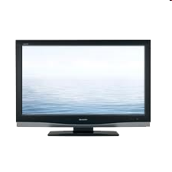


Access net: cable network
cable headend
…
cable
modem
splitter
C
O
N
T
R
O
L
V
I
D
E
O
V
I
D
E
O
V
I
D
E
O
V
I
D
E
O
V
I
D
E
O
V
I
D
E
O
D
A
T
A
D
A
T
A
1
2
3
4
5
6
7
8
9
Channels
frequency division multiplexing: different channels transmitted in different frequency bands
Introduction
1-<number>

Slide 48
Residential access: cable modems
HFC: hybrid fiber coax
  asymmetric: up to 30Mbps downstream, 2 Mbps upstream
network of cable and fiber attaches homes to ISP router
  homes share access to router
deployment: available via cable TV companies
Introduction
1-<number>

Slide 49
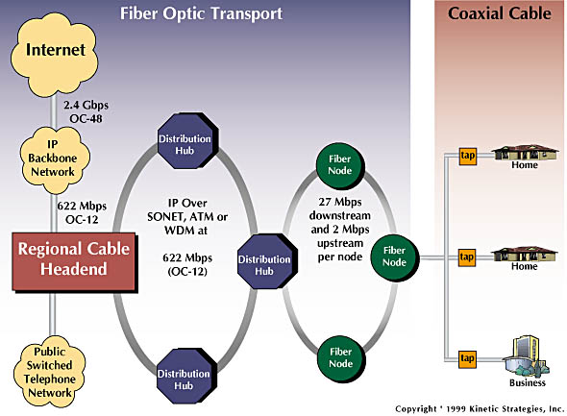
Residential access: cable modems
Diagram: http://www.cabledatacomnews.com/cmic/diagram.html
Introduction
1-<number>

Slide 50
Enterprise access nets: local area networks
company/univ local area network (LAN) connects end system to edge router
Ethernet:
  shared or dedicated link connects end system and router
  10 Mbs, 100Mbps, Gigabit Ethernet
Introduction
1-<number>

Slide 51










Enterprise access networks
institutional link to
ISP (Internet)
institutional router
Ethernet
switch
institutional mail,
web servers
  10 Mbps, 100Mbps, 1Gbps, 10Gbps transmission rates
  today, end systems typically connect into Ethernet switch
Introduction
1-<number>

Slide 52








Wireless access networks
shared wireless access network connects end system to router
  via base station aka “access point”
wide-area wireless access
  provided by telco (cellular) operator, 10’s Km
  between 1 and 10 Mbps
  3G, 4G: LTE, WiMax
wireless LANs:
  within building (50 m)
  802.11b/g (WiFi): 11, 54 Mbps transmission rate
to Internet
to Internet
Introduction
1-<number>

Slide 53




Home networks
router/firewall/NAT
Ethernet
wireless access point
Typical home network components:
ADSL or cable modem
wireless
devices
to/from headend or central office
often combined
in single box
cable or DSL modem
wireless access
point (54 Mbps)
router, firewall, NAT
Introduction
1-<number>
wired Ethernet (100 Mbps)

Slide 54
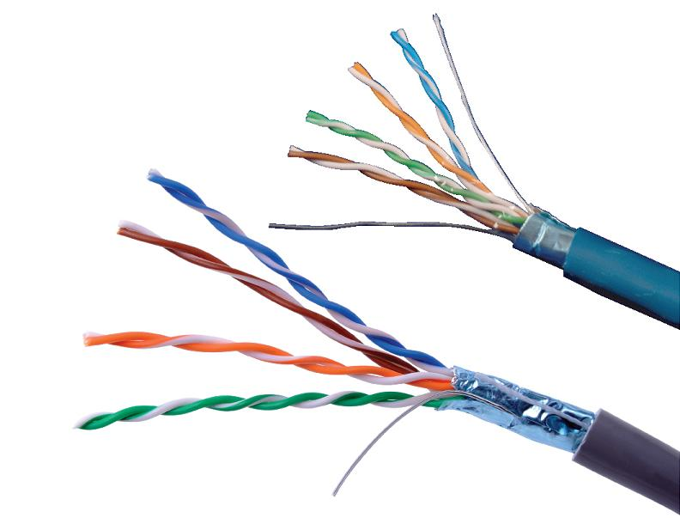
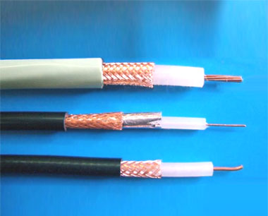
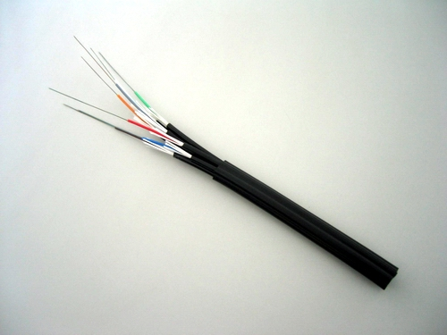
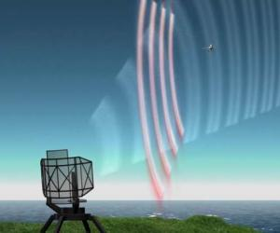
Physical Media
Introduction
1-<number>

Slide 55
Physical Media
Twisted Pair (TP)
two insulated copper wires
  Category 3: traditional phone wires, 10 Mbps Ethernet
  Category 5:
  100Mbps Ethernet
  1 Gpbs Ethernet
  Category 6: 10Gbps
Bit: propagates between
transmitter/rcvr pairs
physical link: what lies between transmitter & receiver
guided media:
  signals propagate in solid media: copper, fiber, coax
unguided media:
  signals propagate freely, e.g., radio
Introduction
1-<number>

Slide 56


Physical Media: coax, fiber
Fiber optic cable:
glass fiber carrying light pulses, each pulse a bit
high-speed operation:
  high-speed point-to-point transmission (e.g., 10’s-100’s Gps)
low error rate: repeaters spaced far apart ; immune to electromagnetic noise
Coaxial cable:
two concentric copper conductors
bidirectional
baseband:
  single channel on cable
  legacy Ethernet
broadband:
  multiple channels on cable
  HFC
Introduction
1-<number>

Slide 57
Physical media: radio
signal carried in electromagnetic spectrum
no physical “wire”
bidirectional
propagation environment effects:
  reflection
  obstruction by objects
  interference
Radio link types:
terrestrial microwave
  e.g. up to 45 Mbps channels
LAN (e.g., Wifi)
  11Mbps, 54 Mbps
wide-area (e.g., cellular)
  e.g. 3G: ~2Mbps
satellite
  Kbps to 45Mbps channel (or multiple smaller channels)
  270 msec end-end delay
  geosynchronous versus low altitude
Introduction
1-<number>

